Slide 1

2025 Convention Site Report
Michelle Werts
Annual Convention Planning Chair
Arabian Horse Association

Slide 2
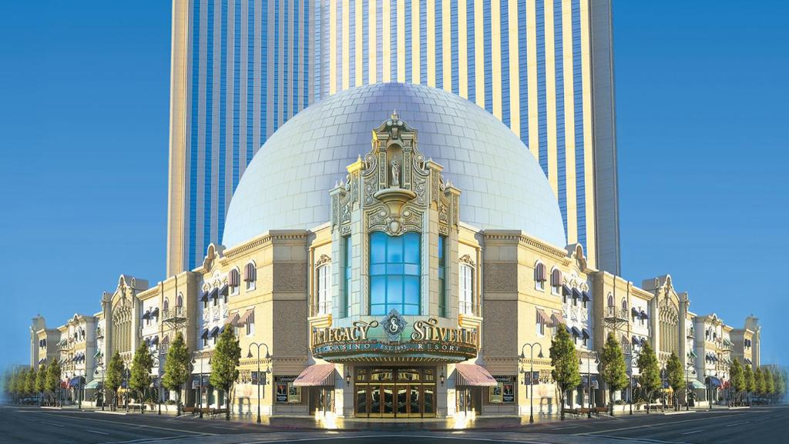
Silvery Legacy
Reno, NV

Slide 3
Room Rates, Catering, and Reno-Sparks CVA Sponsorship
Room block
catering
$69 Sunday – Thursday
$139 Friday/ Saturday
$25 resort fee and 13.5% Occupancy tax and $3.00 city tax/room/night
929 rooms
$38,000 catering min
19.5% Service Charge
8.26% sales tax
Reno-Sparks CVA
$5,000 in sponsorship money if we hit 80% of our room block

Slide 4

Concessions
One complimentary two-bedroom penthouse suite
One complimentary two-bedroom corner spa suite/ hospitality suite
One complimentary player spa suite
25% discount for in- house AV provider off of the prevailing A/V prices over contracted dates
10 complimentary round trip limo transfers to and from Reno Tahoe International Airport
One Giveaway prize
Up to 8 room nights provided complimentary for pre-planning visits
All easel signage

Slide 5
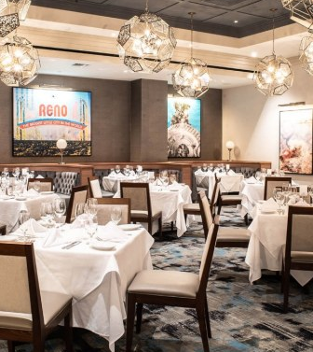

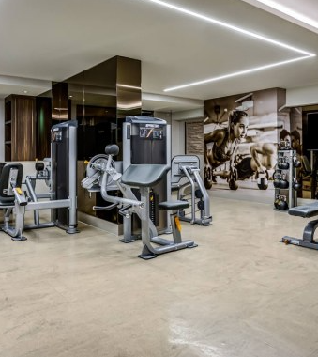
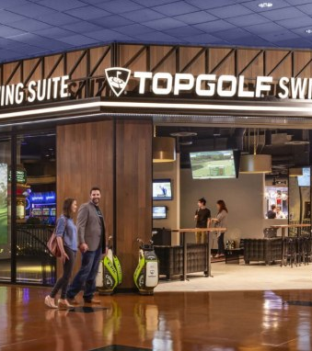
Amenities and Entertainment
25 Outstanding dining choices at THE ROW
Spa & Fitness center and pool
All new Top Golf Swing Suites
Lugh Factory Comedy Club & Showroom
Various unique venues throughout THE ROW
Connected seamlessly to Eldorado and Circus Circus
Casino
Hotel Airport Shuttle
Business Center

Slide 6
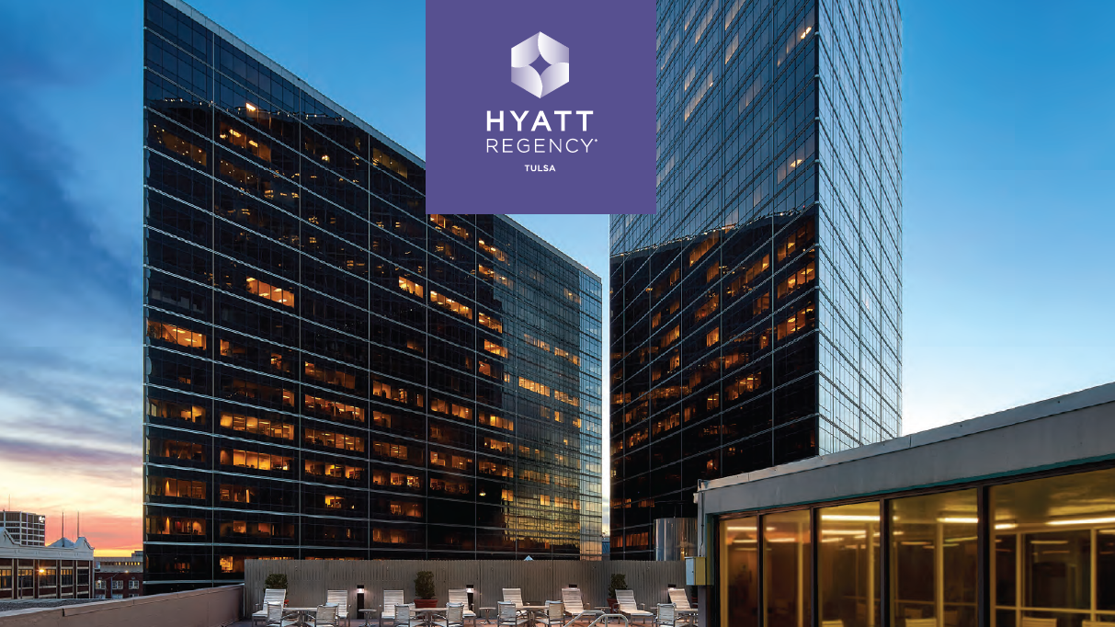
Hyatt Regency Tulsa Downtown
Tulsa, OK

Slide 7
Room Rates and Catering
Room Block
Catering
$159/ room plus
16.517% tax
930 rooms
$40,000 catering min

Slide 8

Concessions
2 Complimentary two-bedroom deluxe suites with parlor
3 executive suite upgrades at group rate for VIPs
10 upgrades to Regency Club Kings at the group rate for BOD
5 Convention Staff rooms Discounted at $110
10 welcome amenities, chef’s choice
Comp ratio 1/50
15 comp valet/ self parking passes
Self parking discounted $12/day
Meeting room rental waived
20% discount on Encore AV Equipment
Complimentary meeting room WIFI

Slide 9
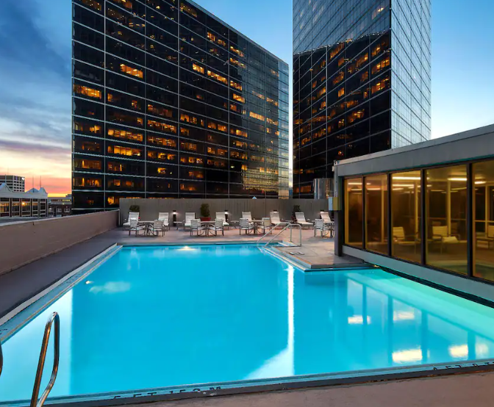
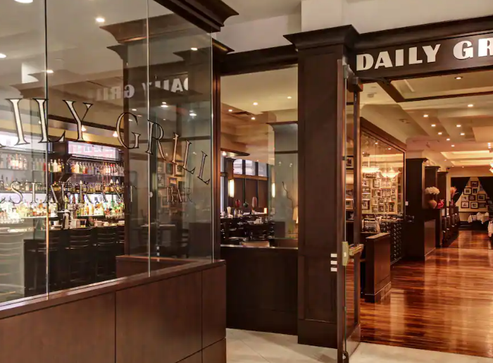
Amenities
Hotel Restaurant
Coffee Shop
Salon and Spa
Fitness Center
Business Center
Indoor/ Outdoor Pool
Walkable to downtown Tulsa
Hotel Airport Shuttle

Slide 10
Site Comparison Snapshot - Attendee Costs
 | Reno | Tulsa | Required / Preferred
Number of Rooms | 929 | 930 | 350
Room Rate | $69 - $139 | $159
Resort Fee | $25 | $0
Taxes | 13.5% + $3/night | 16.517%
Total Room Fee/Night | $110-$189 | $185 | Less than $200
Catering Minimum | $38,000 | $40,000 | $40,000 or less
Sponsorship | $5,000 with 80% of room block | $0
Airport Shuttle | Yes | Yes | Yes
Airfare | Avg $380 | Avg $330
Virtual Convention has no travel or hotel costs for attendees but does incur costs for production.

Slide 11

The Arabian Horse Association
6030 Greenwood Plaza Blvd, Unit 100 | Greenwood Village, CO 80111
303-696-4500
ArabianHorses.org

